Slide 1
Blue Cross Blue Shield Horizon Blue: heuristic evaluation
October 2022

Slide 2
Heuristic analysis Of Blue Horizon Blue Consumer portal
We have evaluated the current user experience with Jakob Nielsen’s 10 standard heuristics principles.
Visibility of System Status
Match Between System and The Real World
User Control and Freedom
Consistency and Standards
Error Prevention
Recognition Rather Than Recall
Flexibility and Efficiency of Use
Aesthetic And Minimalist Design
Help Users Recognize, Diagnose, And Recover From Errors
Help And Documentation

Slide 3
Expert Review
Three-point scale
2 High
Imperative to fix, needs to be worked on before the product can be released:
5 Medium
Important to fix and should be considered before product can be released:
2 Low
Need not be fixed unless extra time is available on project:
Summary of problems observed in this category
Typographical inconsistency and issues
White spacing
Additional features for the better user experience
Placements of the objects
Summary of problems observed in this category
Cosmetics or style related issues
Paginations
Vertical scroll bars
Summary of problems observed in this category
Primarily the consistency issues
Variation in the layouts for the same or similar features
Navigation/Menu & actions related issues
Horizontal scrolling which are not part of the design
Please Note:
Observations are made purely on the basic understanding and UX best practices
Some of the observation might differ as they might be implemented due to business or technical requirements
* Usability Standards: ISO 9241-210:2010 Ergonomics of human-system interaction -- Part 210: Human-centered design for interactive systems
** Accessibility Standards: http://www.w3.org/standards/webdesign/accessibility

Slide 4
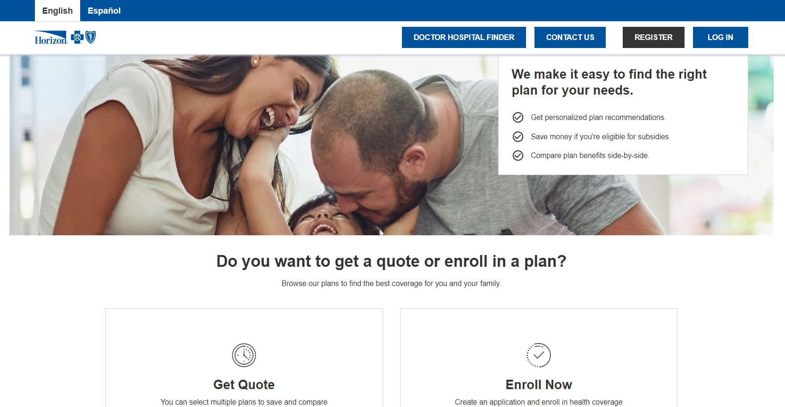
Heuristic evaluation – Consumer Portal
Home page
Medium
Heuristic: Flexibility and Efficiency of use
Issue: “Get Quote” and “Enroll Now” are the primary action items which are not accessible to the users unless scrolled down. Also, these buttons don’t have any hover effect. This behavior makes these cards less accessible, efficient and discoverable.
Recommendation: “Get Quote” and “Enroll Now” buttons could appear within Hero banner and provide clearer visual cue for clicking.
Low
Heuristic: Aesthetic and minimalist design
Issue: Top blue bar and blue buttons in the top header are too prominent and stealing attention away from primary tasks.
Recommendation: Language selection can be moved in white header below and make blue buttons less prominent so that users can focus on the primary intent of the page.

Slide 5
Heuristic evaluation – Consumer Portal
Get A Quote
High
Heuristic: Visibility of system status
Issue: This page needs to clearly indicate the primary function/purpose. User can have hard time to find out what’s the current page and functionality offered.
Recommendation: Every page in quote creating flow can have “Create a Quote” page title
Heuristic: User control and freedom
Issue: This page need a clearly marked “Exit” to leave get a quote workflow.
Recommendation: Provide close / exit button so that user can exit this process at any time.
Medium
Heuristic: Aesthetic and minimalist design
Issue: The hero banner is taking too much of real estate and attention unnecessarily.
Recommendation: Eliminate Hero banner in order to make quoting questions prominently.

Slide 6
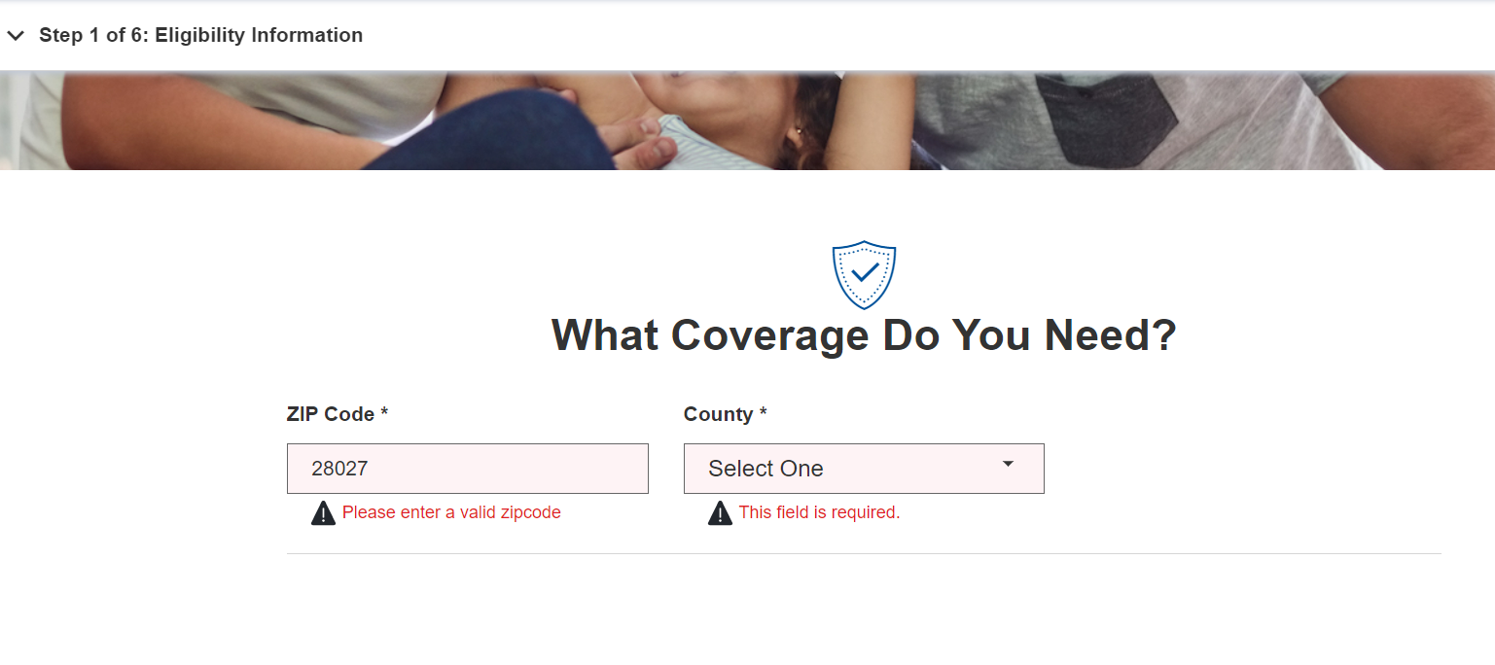
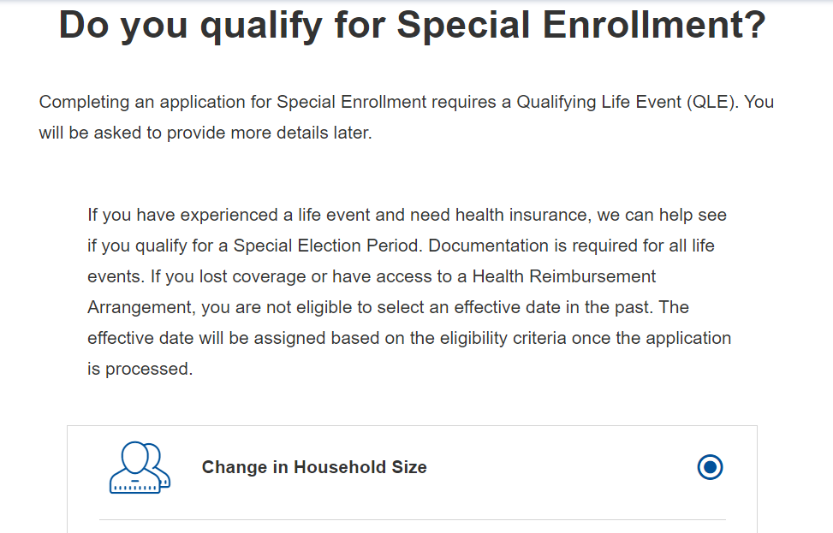
Heuristic evaluation – Consumer Portal
Get A Quote
High
Heuristic: Visibility of system status
Issue: Blue Horizon offers services in only specific zip codes. This page does not clearly communicate this information. Also, this UI prompts inaccurate / misleading error message even after providing a valid zip code.
Recommendation: Provide clear instructions and appropriate error message about acceptable zip codes to eliminate error-prone condition.
Low
Heuristic: Aesthetic and minimalist design
Issue: This page requires users to excessively scroll back-and-forth to read questions and the options. This behavior can be annoying to user and harm users’ focus.
Recommendation: Arrange page content to reduce motor movements and cognitive load.

Slide 7
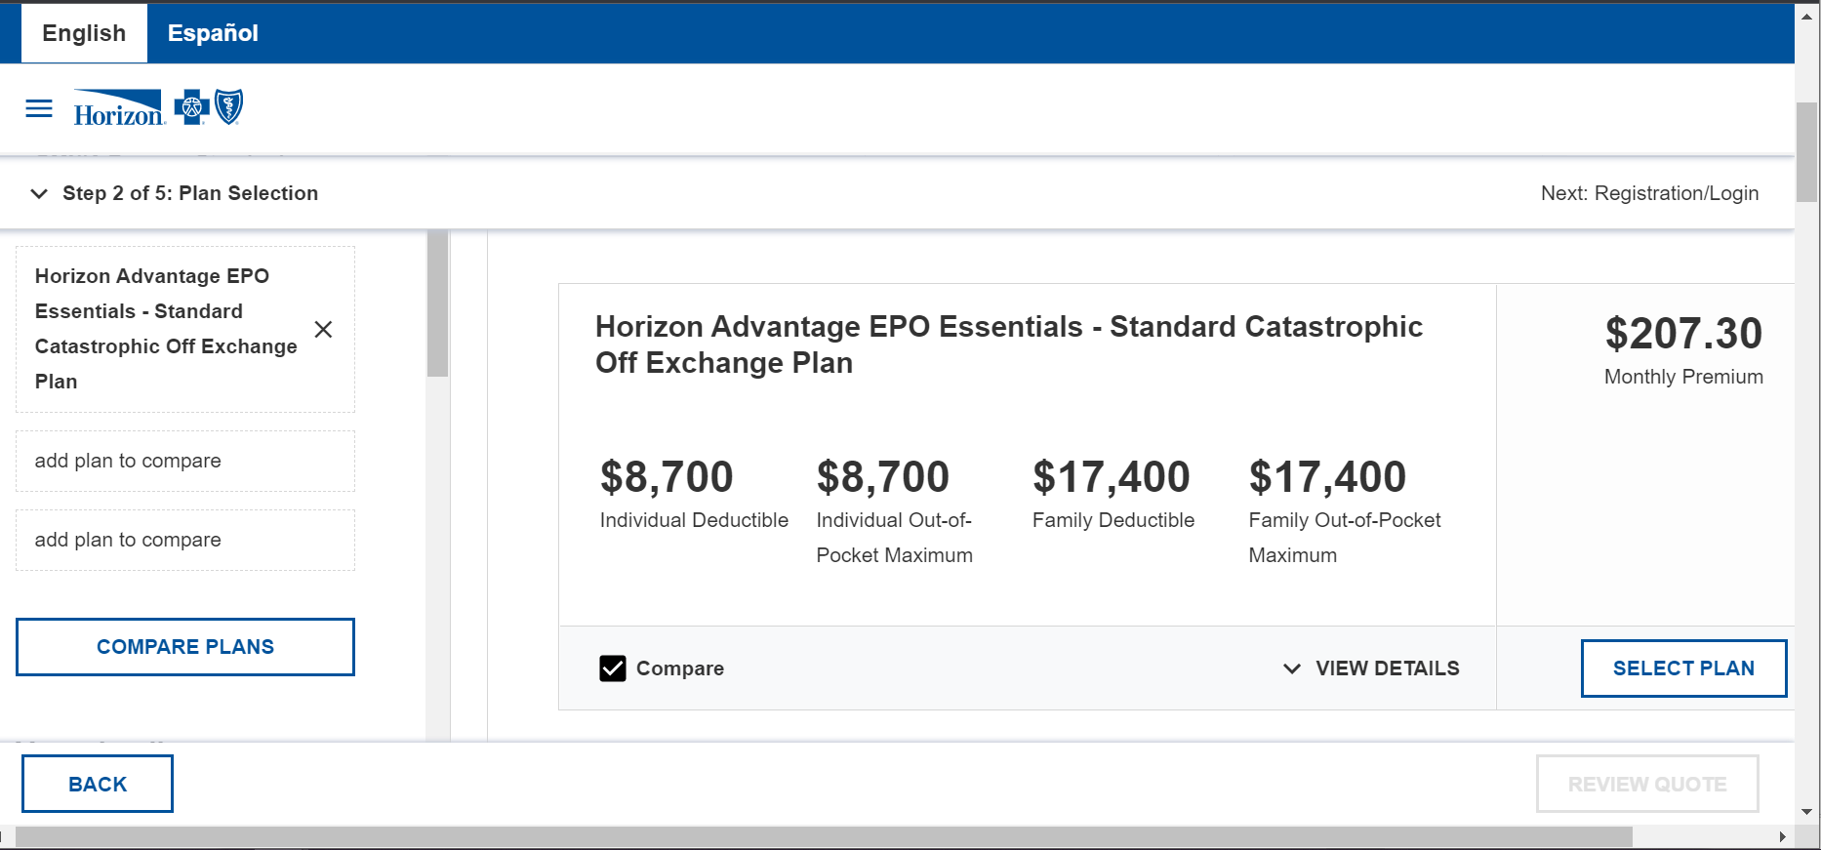
Heuristic evaluation – Consumer Portal
Get A Quote
Medium
Heuristic: Aesthetic and minimalist design
Issue: Too many horizontal, vertical and internal scrolling causes too much of motor load on the user. User must constantly scroll back-and-forth to access different information and functionality.
This behavior can be annoying to user and harm users’ focus.
Recommendation: Arrange Compare section and plan filters in a way, which can be seen and accessed easily without scrolling a lot. Make “COMPARE PLANS” function more intuitive.
Issue: Multiple buttons (Compare plans, Select Plans, Back, Review quote) with similar level of importance and visual treatment causes conflict and divided attention.
Recommendation: Maintain proper visual hierarchy in button treatment. Each page should have only one primary action button and rest secondary or tertiary actions.

Slide 8
Blue Cross Blue Shield Horizon Blue: Proposed Design
October 2022

Slide 9
View the interactive prototype of the proposed design >

Slide 10
Proposed Design for Horizon Blue - Consumer Portal
Home page
Before
After
1
2
Intuitive, clear navigation and visual hierarchy which allows users attention to primary UI elements
Emphasized hero banner content
Accessible and above the fold Call-To-Action buttons for “Get a Quote” and “Enroll Now” actions so that users don’t have to scroll down
3

Slide 11
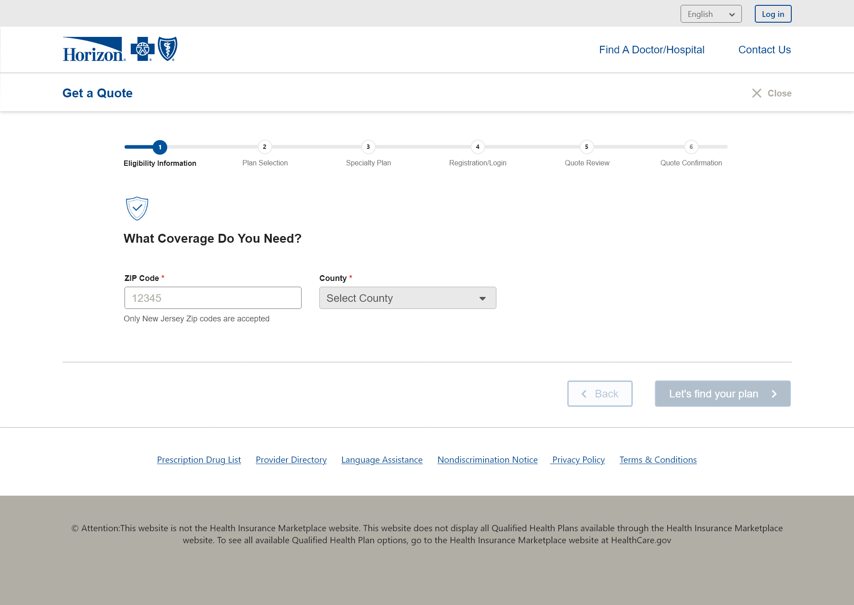
Proposed Design for Horizon Blue - Consumer Portal
Get a Quote
Before
After
1
1
2
3
2
Prominent page heading to provide clear context to the user
Close button to allow users to exit the quoting process so that users don’t feel stuck
Horizontal progress stepper for better visibility of the progress
Contextual help notes to prevent users from making errors
4
3

Slide 12
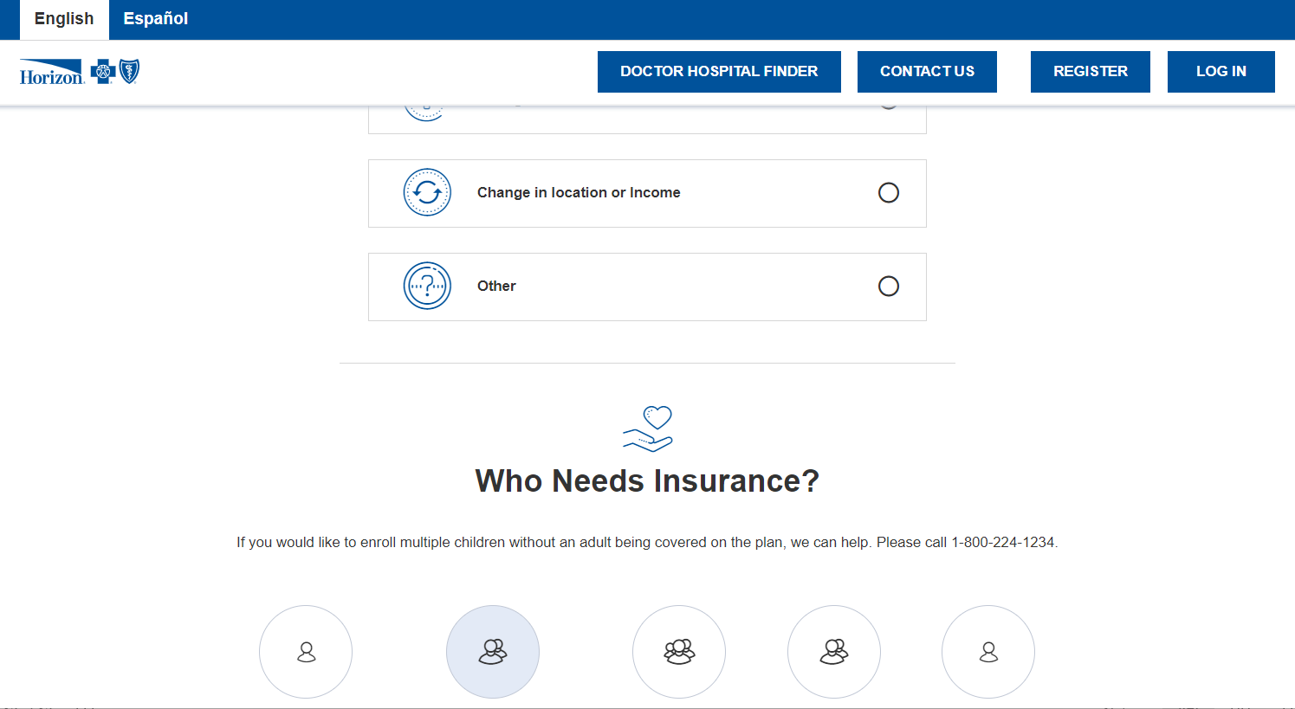
Proposed Design for Horizon Blue - Consumer Portal
Get a Quote
Before
After
1
Horizontally aligned tiles provide better visual flow and less need to scroll back-and-forth
Consistent visual treatment for similar elements for better aesthetic appeal and lesser cognitive load
2

